Slide 1
19CSE211
MIPS Pipeline Data Hazard
Term2 Session4
Stalling
04-03-2021

Slide 2
Identify the Hazard and reorder the code
lw $t1, 0($t0)
lw $t2, 4($t0)
add $t3, $t1, $t2
sw $t3, 12($t0)
lw $t4, 8($t0)
add $t5, $t1, $t4
sw $t5, 16($t0)

Slide 3
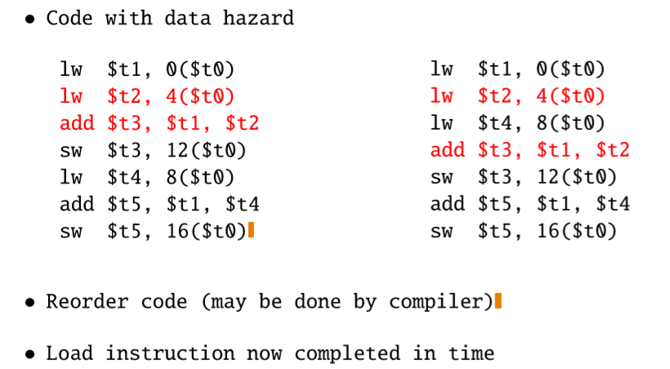

Slide 4
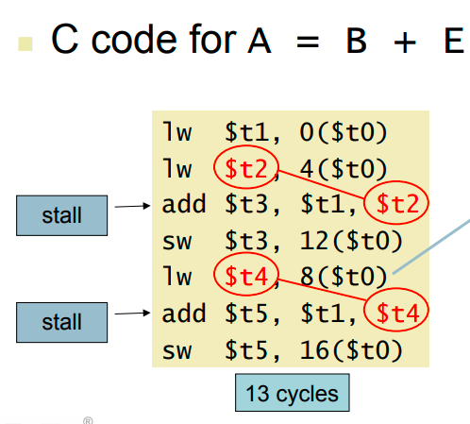

Slide 5
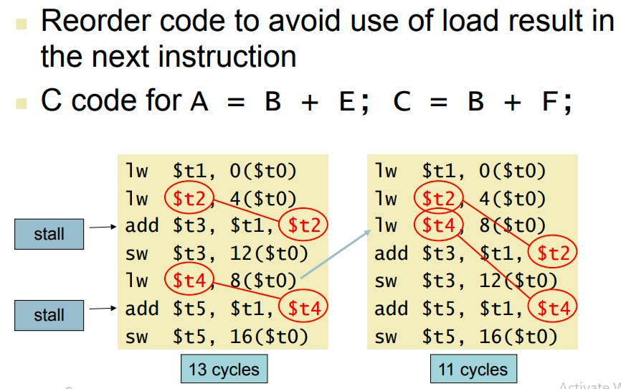

Slide 6

Stalling - load and Subtract
Load and Use Data Hazard

Slide 7
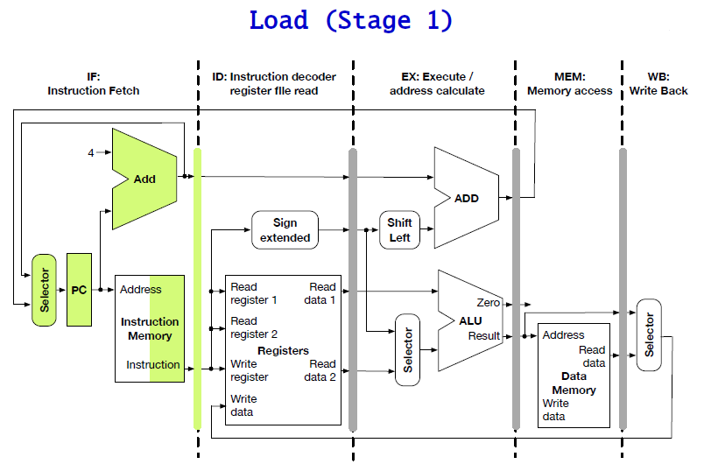

Slide 8
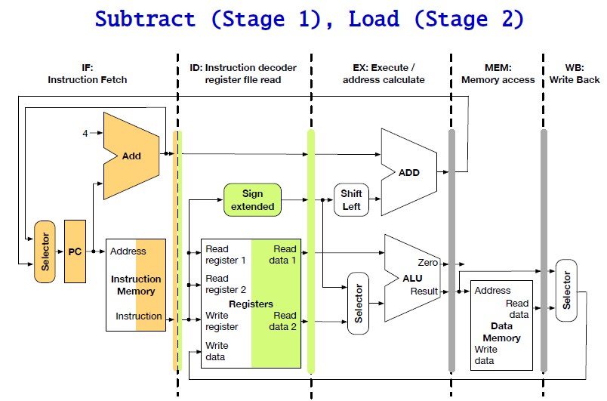

Slide 9
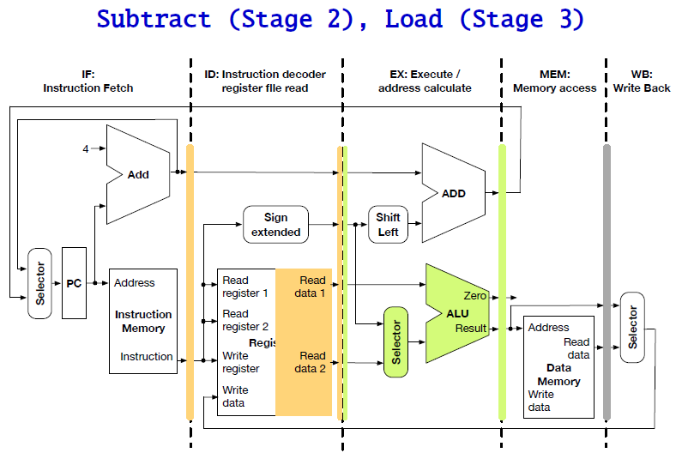

Slide 10
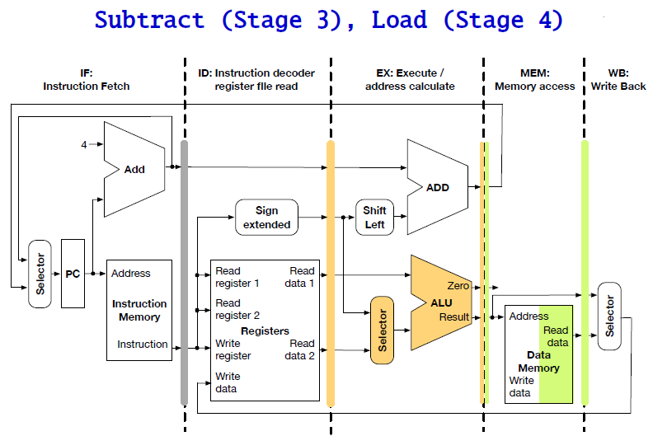

Slide 11
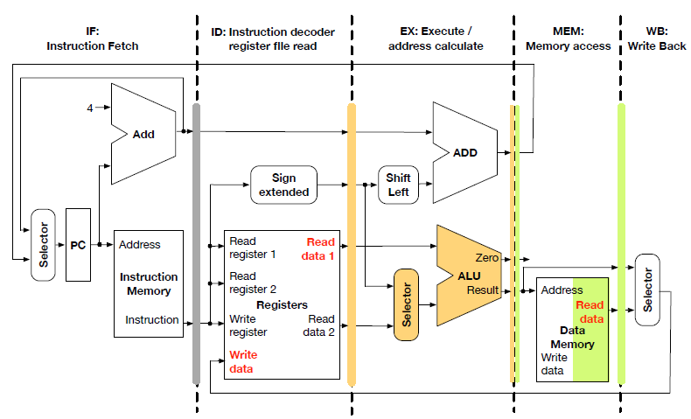
Data Hazard

Slide 12
Data Hazard
Our example
load $s0, 20($t0)
sub $t0, $s0, $t3
Worse than add/sub hazard
we need operand value in $s0
we have not even retrieved it at this stage
Stalling
load instruction processing has to move to stage 5
sub instruction processing has to stall

Slide 13
Data Hazard
Hazard condition between 2 instructions
Second instruction has to be delayed
Technical solution: insert a "nop" operation ("no operation")
Resets program counter

Slide 14
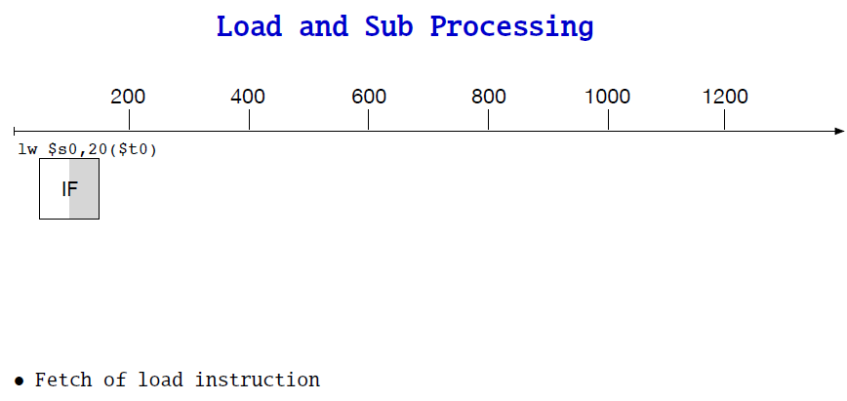

Slide 15
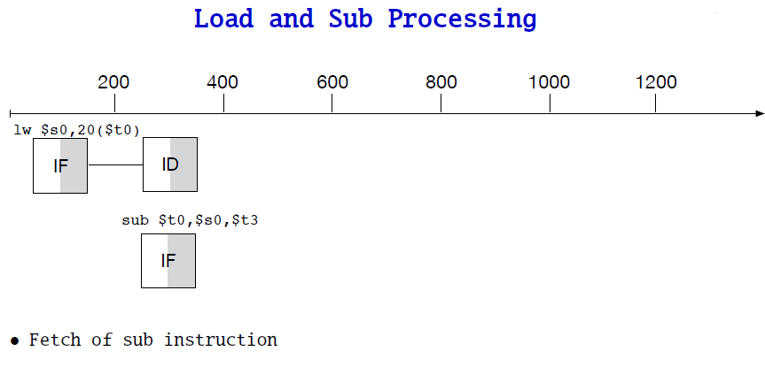

Slide 16
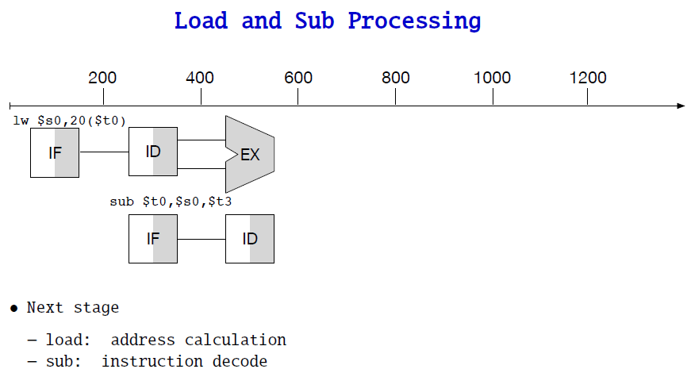

Slide 17
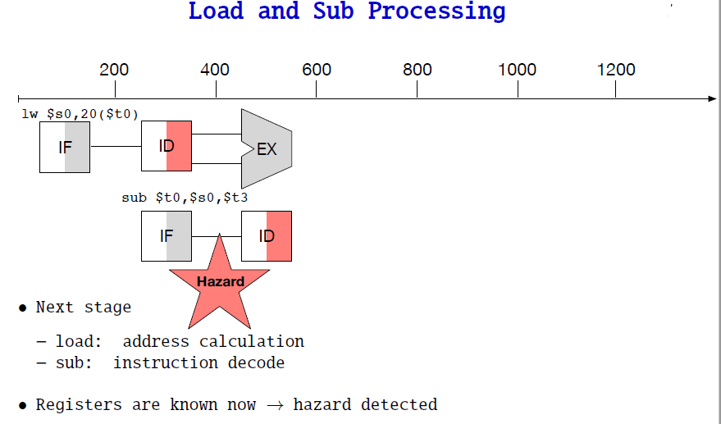

Slide 18
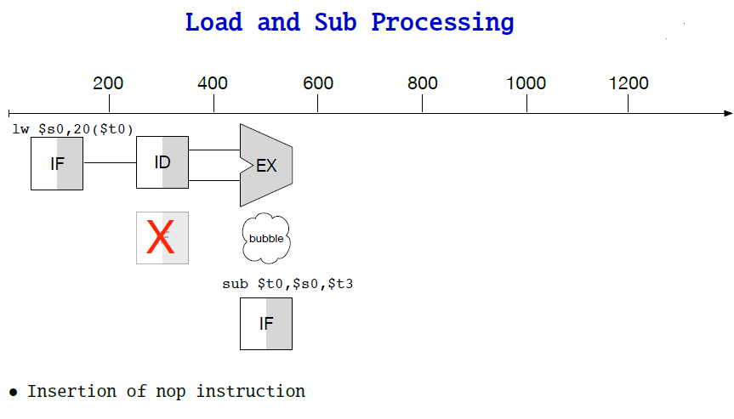

Slide 19
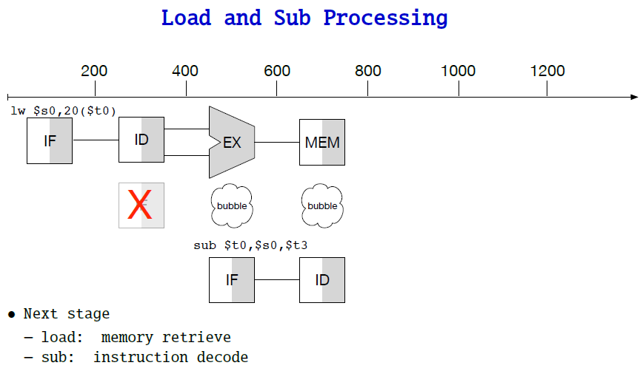

Slide 20
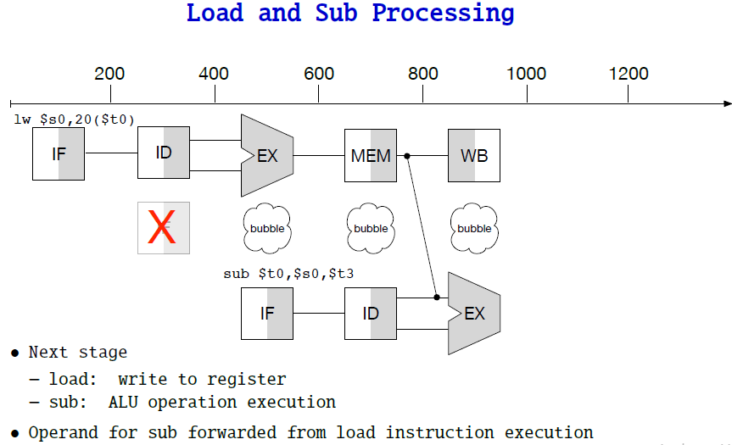

Slide 21
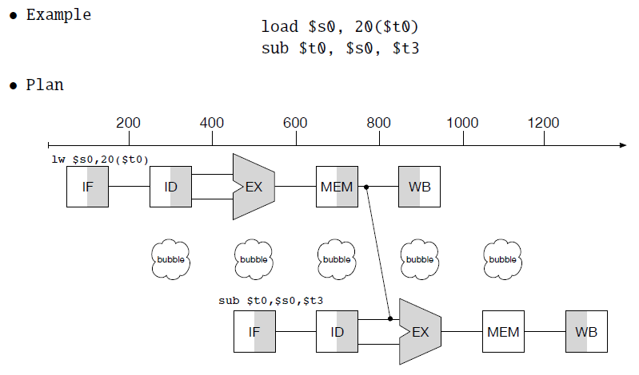
Stalling - load and Subtract

Slide 22
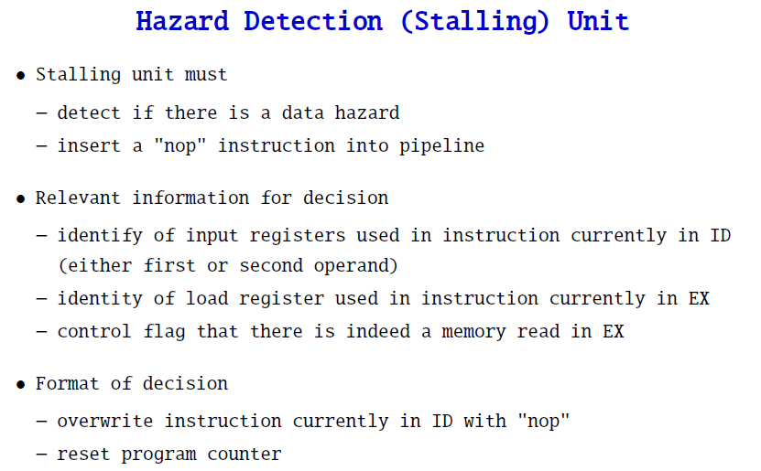

Slide 23
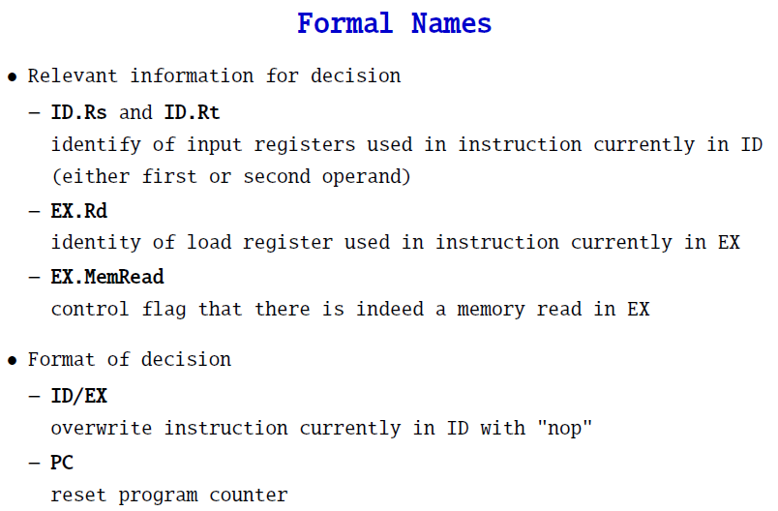

Slide 24
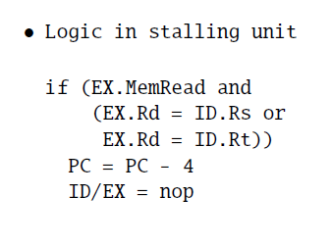

Slide 25
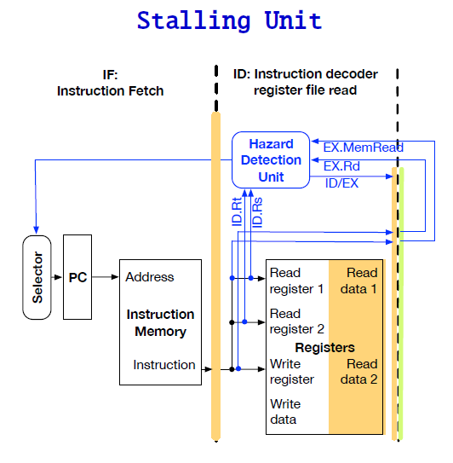

Slide 26
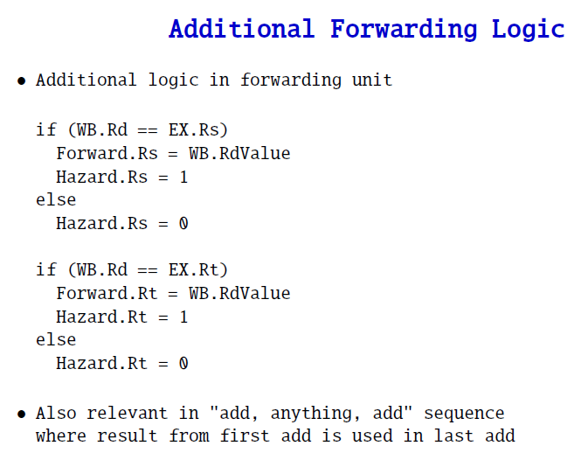

Slide 27
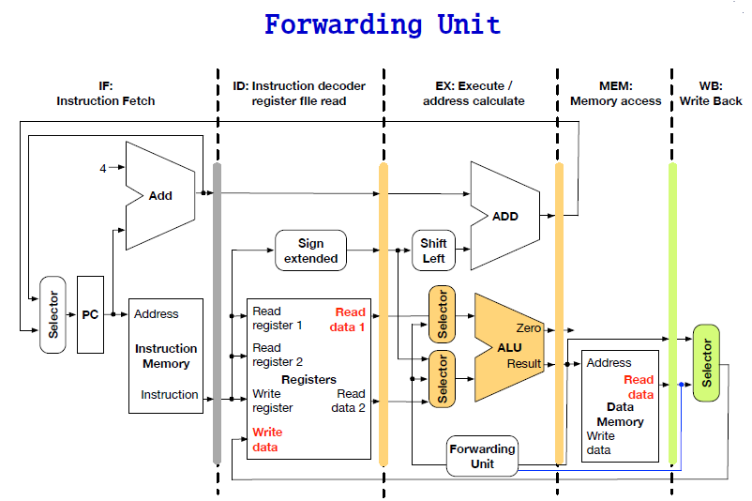

Slide 28
Reference and Courtesy: http://www.cs.jhu.edu/~phi/csf/ http://www.cs.jhu.edu/~phi/csf/slides/lecture-mips-pipelining.pdf http://www.cs.jhu.edu/~phi/csf/slides/lecture-mips-hazards.pdf https://eecs.oregonstate.edu/research/vlsi/teaching/ECE472_FA12/chapter4_pipelining_END_FA11.pdf

